Slide 1
MONO- E DUAL AGONIST E LOW ENERGY KETOGENIC THERAPY: UN SINERGISMO OLTRE LA PERDITA DI PESO?
LUIGI SCHIAVO
DIPARTIMENTO DI MEDICINA, CHIRURGIA E ODONTOIATRIA
UNIVERSITA’ DEGLI STUDI DI SALERNO

Slide 2
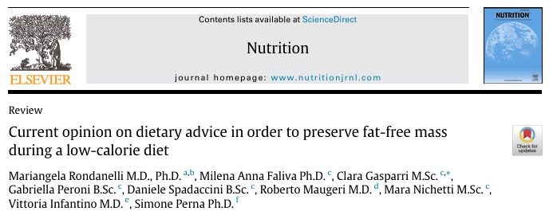

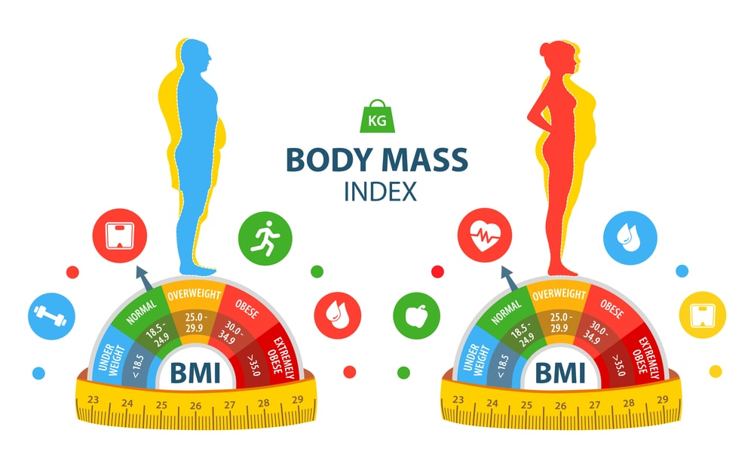
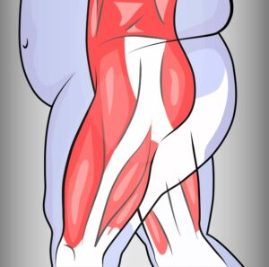
WEIGHT LOSS MAIN OBJECTIVE
PRESERVE FAT-FREE MASS
Volume 72, April 2020, 110667
A substantial decline in FFM may:
Negatively affect resting metabolic rate (RMR)
Slow weight loss progression
Heighten the risk of muscle strength (MS) loss and sarcopenia
Increase susceptibility to weight regain

Slide 3
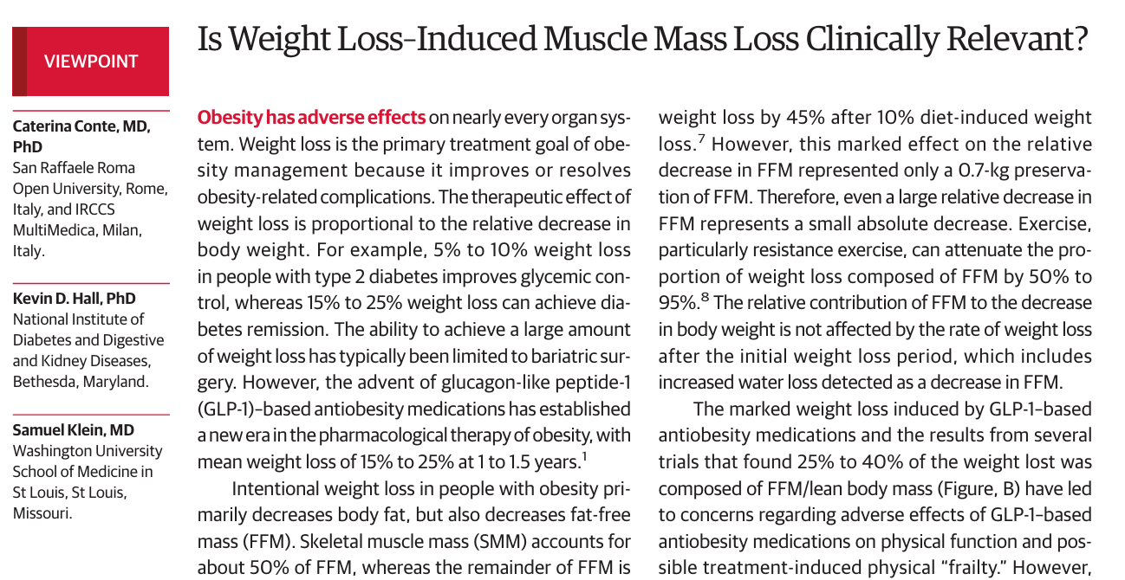
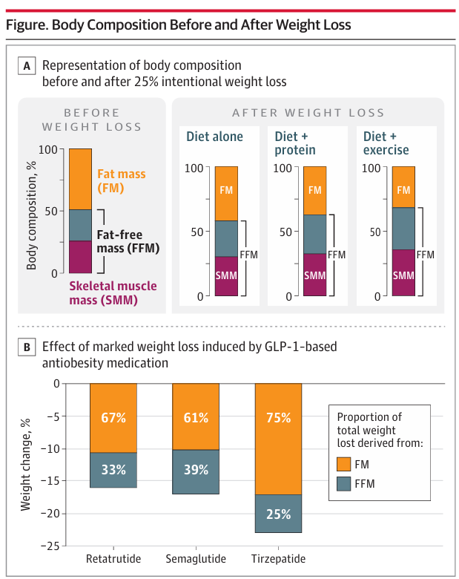
WEIGHT LOSS MAIN OBJECTIVE
TITOLO SLIDE
JAMA July 2, 2024 Volume 332, Number1
Several trials found 25% to 40% of the weight lost was composed of FFM have led to concerns regarding adverse effects of GLP-1–based anti-obesity medications on body composition changes
1:3

Slide 4
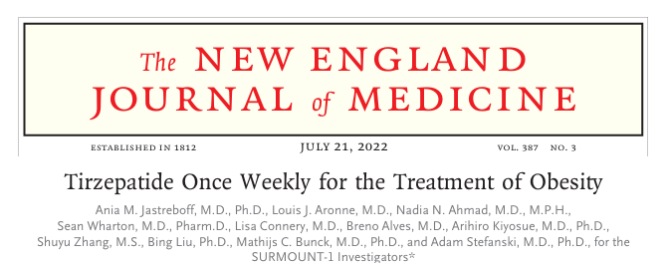
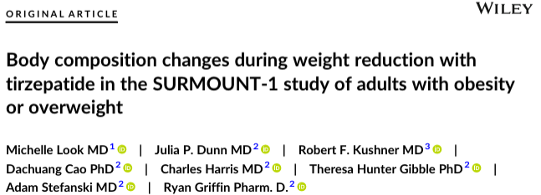
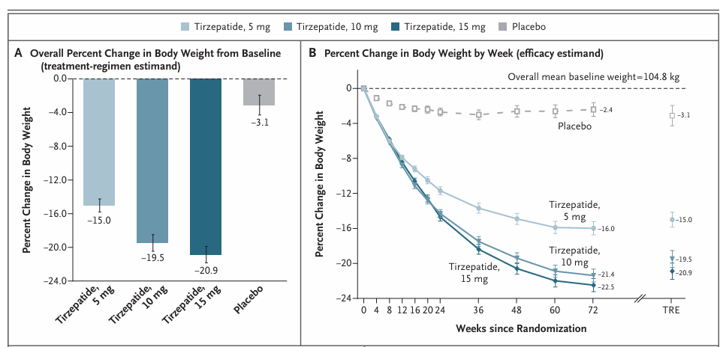
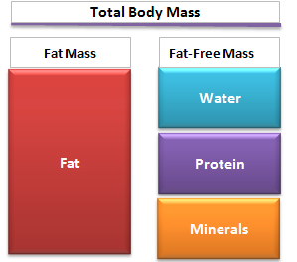
SURMOUNT 1 STUDY
Diabetes Obes Metab.2025;27:2720-29
LCD = - 500 calories per day
Therefore, preventive measures should be implemented early during TZP therapy to mitigate FFM loss and preserve MS and RMR
33.9%
10.9%

Slide 5
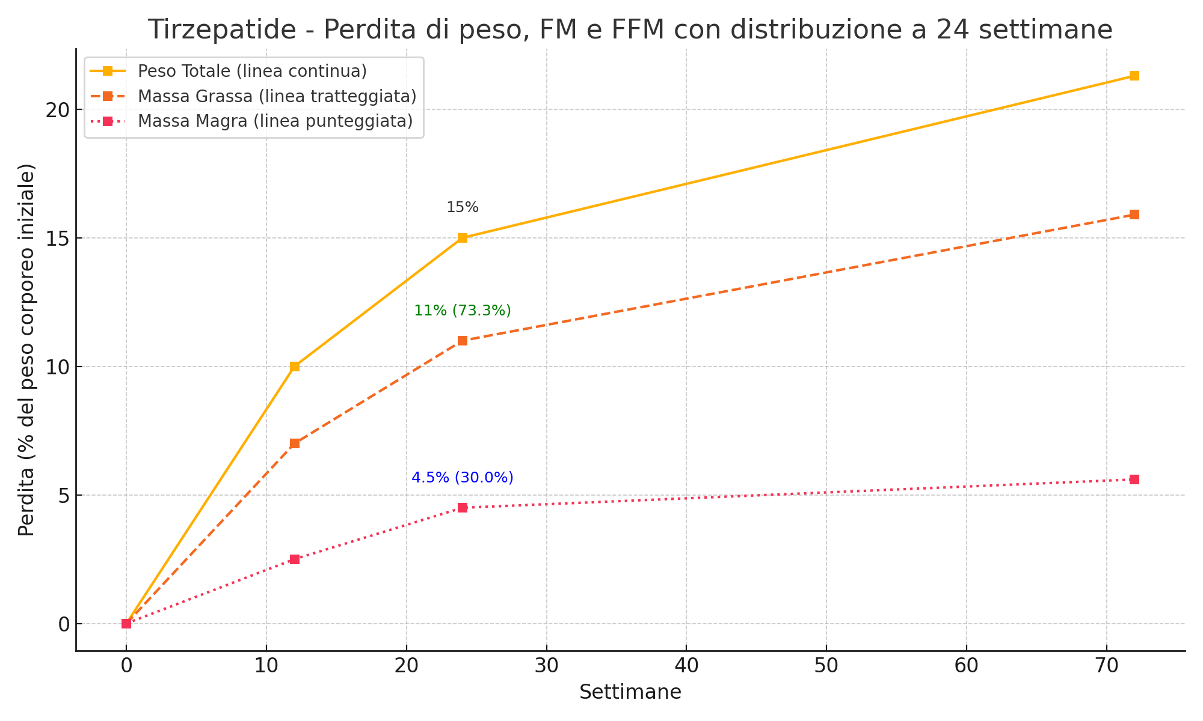
Reduction of FM (kg) after VLCKD. n Comparison of the mean difference in FM (kg) between VLCKD and controls.
SURMOUNT 1 STUDY
WEIGHT, FM and FFM LOSS AT 24 WEEKS
I valori tra parentesi mostrano la proporzione della perdita totale a 24 settimane
Rubino D, et al. NEJM 2021;384:989–1002
Wharton S, et al. Obesity (Silver Spring). 2023;31(6):1333–1342
Schiavo L, et al. Nutrients. 2025
Look M, et al. Diabetes Obes Metab. 2025;27:2720–2729
Tinsley GM, Heymsfield SB. J Endocr Soc. 2024;8(11):bvae164

Slide 6
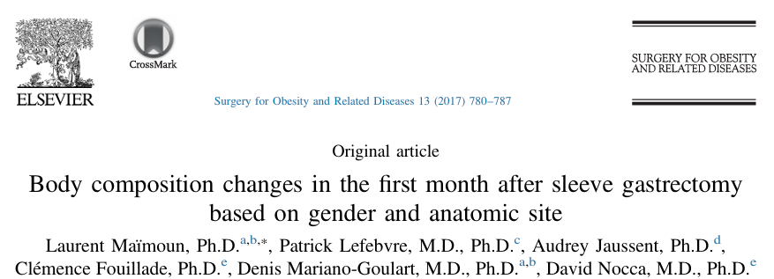
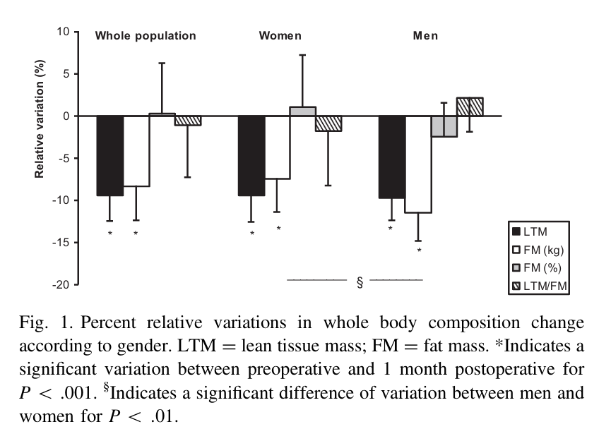
Patients: 41 (33 women, 80.5%)
One month after SG:
Mean weight loss was –9.8 kg ± 2.6 kg
Decrease in FM: -8.3 ± 4.0%
Decrease in LTM: from – 7.3 to 9.5 %
In the absence of specific postoperative nutritional care, the early and acute loss of weight 1 month after BS is also due to a considerable body FFM loss.

Slide 7
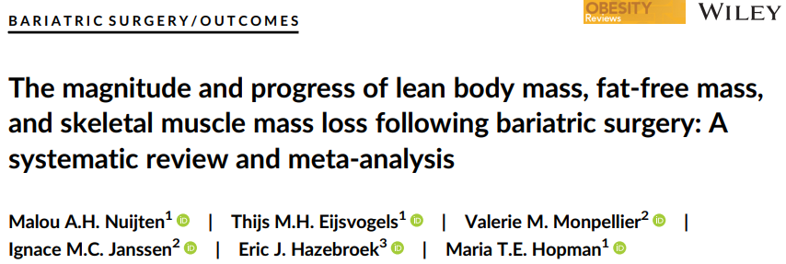
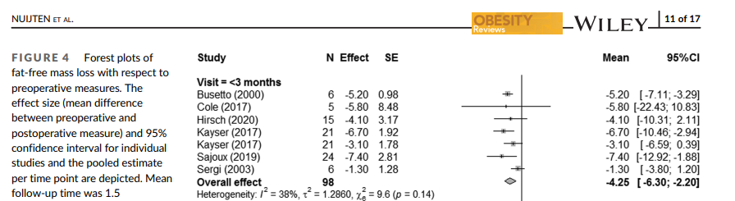
SURMOUNT 1 STUDY
2022;23:e13370
55% of FFM loss is lost within the first post operative 3 months
Highlighting that interventions to mitigate such losses should be implemented soon

Slide 8
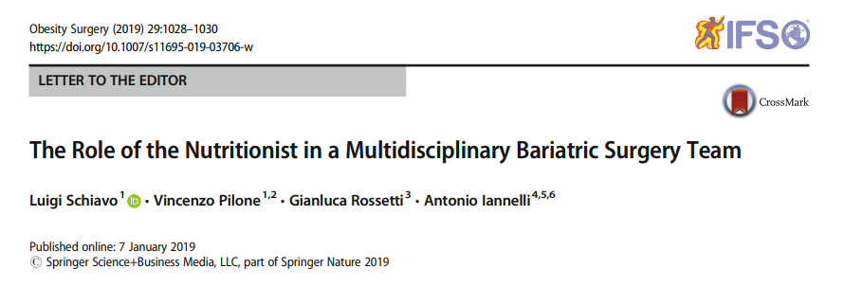

SURMOUNT 1 STUDY
BARIATRIC SURGERY or PHARMACOTHERAPY induced-weight loss is more EFFECTIVE and HEALTHIER when combined with NUTRITIONAL CARE

Slide 9
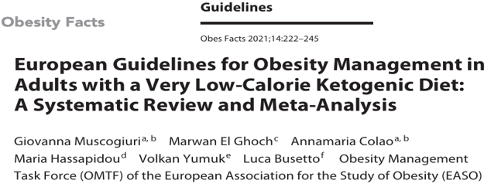
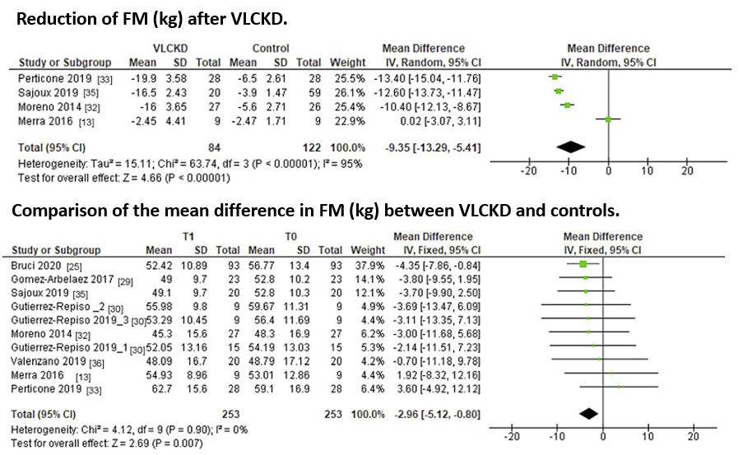
Reduction of FM (kg) after VLCKD. n Comparison of the mean difference in FM (kg) between VLCKD and controls.
SURMOUNT 1 STUDY
Compared to any weight loss intervention, a VLCKD showed superiority in the reduction of FM

Slide 10
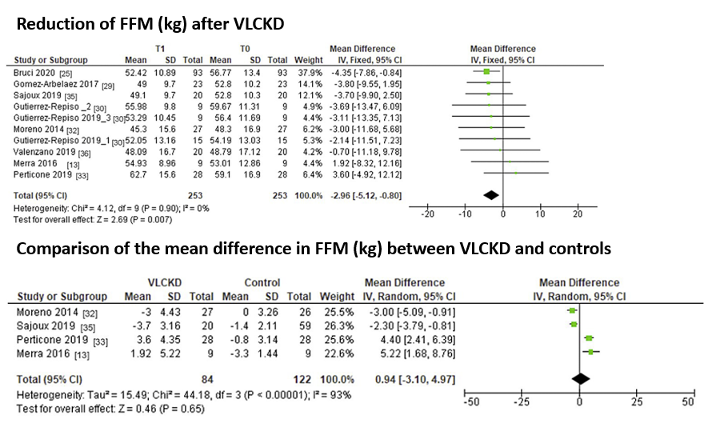
p Comparison of the mean difference in FFM (kg) between VLCKD and controls.
SURMOUNT 1 STUDY
no significant difference
on the reduction in FFM

Slide 11
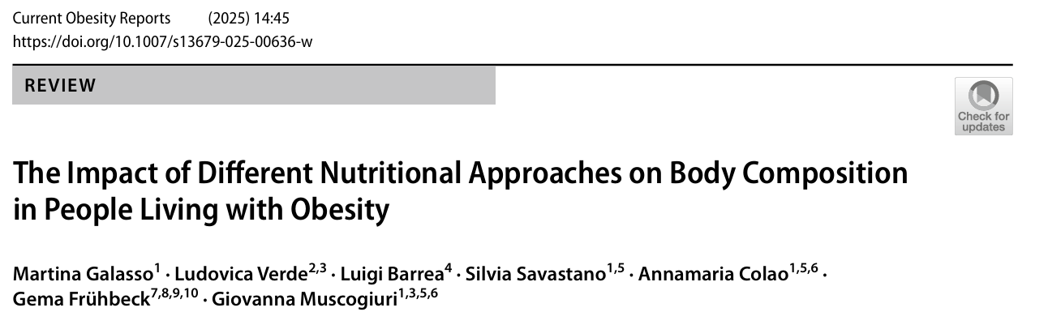
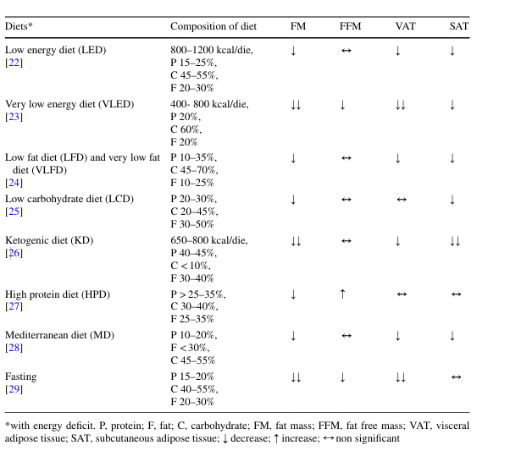
SURMOUNT 1 STUDY
Ketogenic diets are associated with greater preservation of FFM

Slide 12
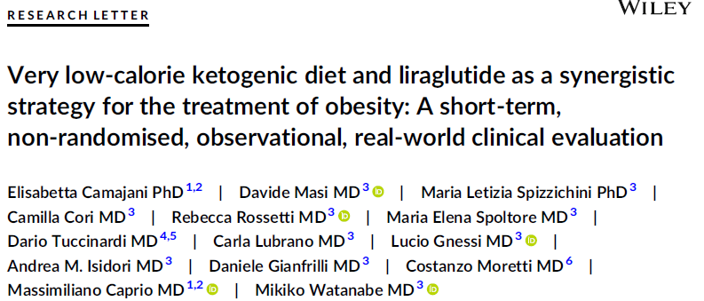
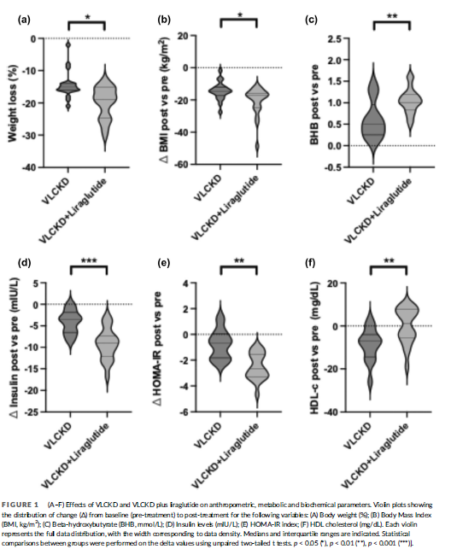
NAPOLI

Slide 13
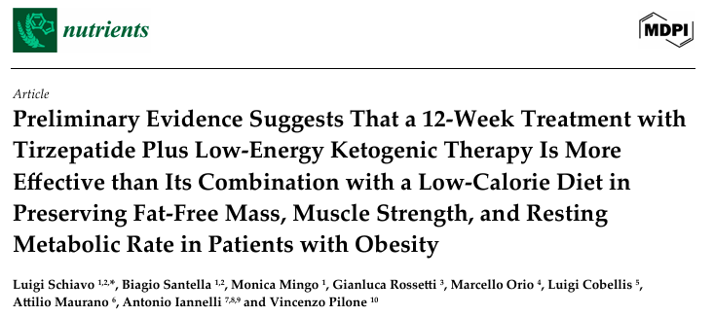
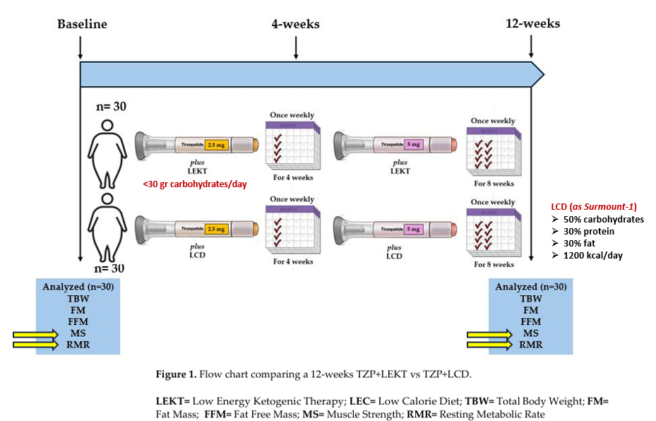
2025, 17, 1216
SURMOUNT 1 STUDY

Slide 14
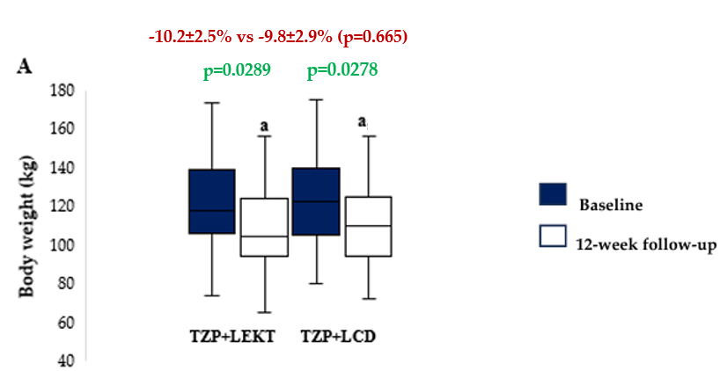
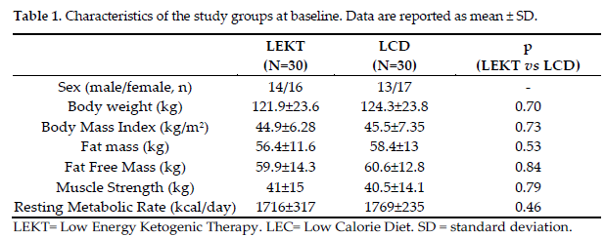
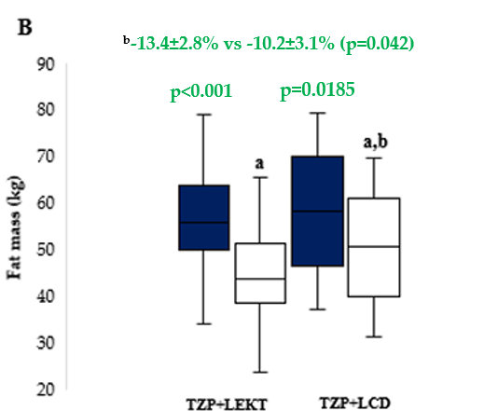
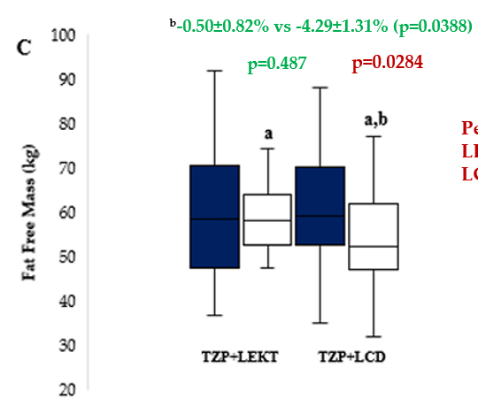
SURMOUNT 1 STUDY
RESULTS
Figure 2. Box plots showing baseline and 12-week follow-up changes in body weight (A), fat mass (B), and fat free mass (C) in both groups study. The horizontal bars represent the median values. Lower and upper boundaries of the box represent the first and the third quartile, respectively. Lower and upper error bars represent the minimum and the maximum value, respectively.
ª12-week follow-up vs baseline
^{b}12-week follow-up TZP+LEKT vs LCD

Slide 15
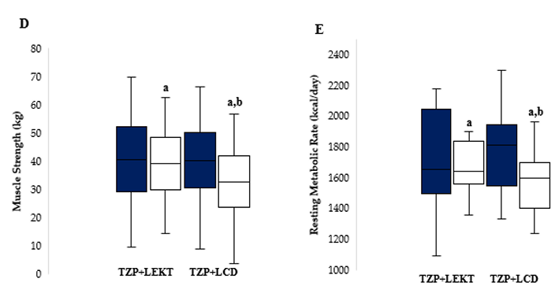
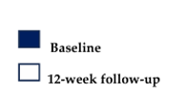
SURMOUNT 1 STUDY
RESULTS
^{b}-0.3±0.9% vs -4.1±1.2% (p=0.046)
^{b}-1.2±0.9% vs -5.3±1.8% (p=0.019)
p=0.691
p=0.0341
p<0.001
p=0.263
Figure 2. Box plots showing baseline and 12-week follow-up changes in muscle strength (D) and resting metabolic rate (E) in both groups study. The horizontal bars represent the median values. Lower and upper boundaries of the box represent the first and the third quartile, respectively. Lower and upper error bars represent the minimum and the maximum value, respectively.
ª12-week follow-up vs baseline
^{b}12-week follow-up TZP+LEKT vs LCD

Slide 16
SURMOUNT 1 STUDY ANALYSIS AT 12 WEEK
SURMOUNT 1 STUDY
LCD = - 500 calories per day
72w
72w
33.9%
10.9%
12w
12w
8.5%
vs
13.4%
our study (LEKT)
1.9%
vs
0.5%
our study (LEKT)

Slide 17
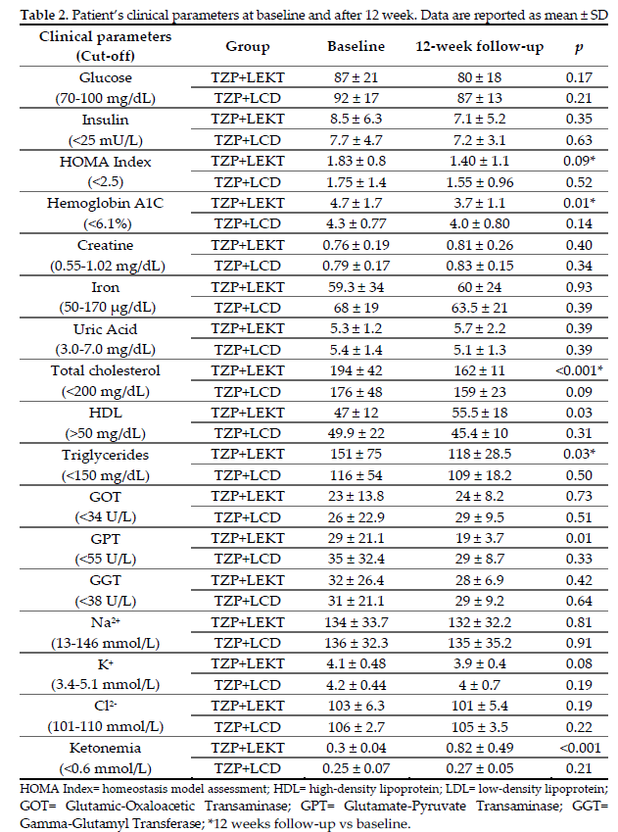
SURMOUNT 1 STUDY
RESULTS

Slide 18
SURMOUNT 1 STUDY
PROPOSED MECHANISMS OF FFM, MS, AND RMR PRESERVATION BY LEKT
+
WEIGHT LOSS BY LEKT
FIBROBLAST GROWTH
FACTOR 21
Keton bodies
+
-
-
+
MITOCOND. EFFICIENCY &
LIPID OXIDATION
GLUCONEO-
GENESIS
MYOSTATIN
MUSCLE STRENGTH
+
-
MUSCLE PROTEOLYSIS
PROTEIN
SYNTHESIS
PROTEOLISYS
+
+
-
+
+
FFM PRESERVATION
MUSCLE MAINTENANCE
PI3K/Akt/mTOR Pathway
+
+
+
MITOCOND. BIOGENESIS
+
ENERGY EFFICIENCY
AMPK
&
PGC-1α
+
RESTING METABOLIC RATE
OXIDATIVE METABOLISM

Slide 19
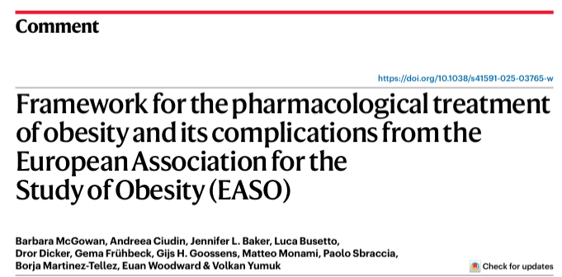
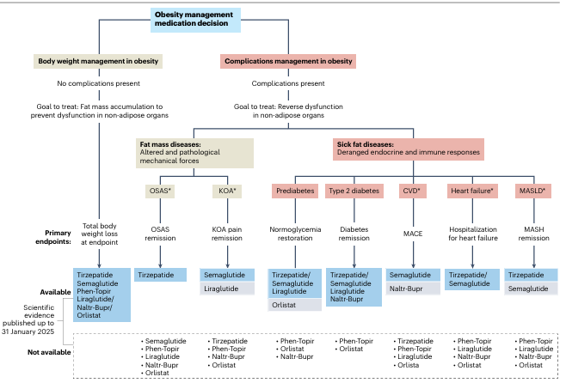
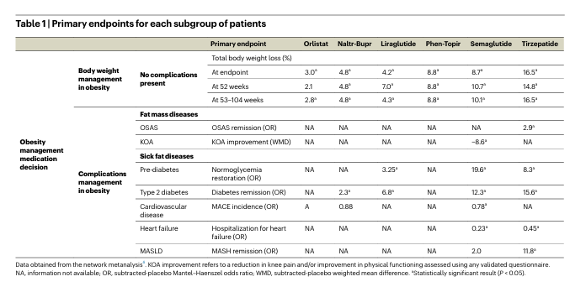
2025 Oct;31(10):3229-3232
Only two trials on MASLD (one with semaglutide and one with tirzepatide).
Only tirzepatide (Table 1) has demonstrated a significant effect on resolution of MASH and liver fibrosis improvement (that is, resolution of MASH without worsening of fibrosis and a reduction of at least one fibrosis stage without worsening of MASH).

Slide 20
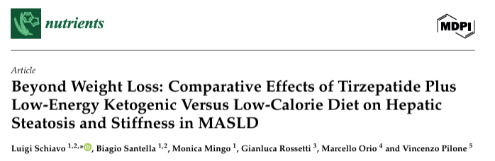
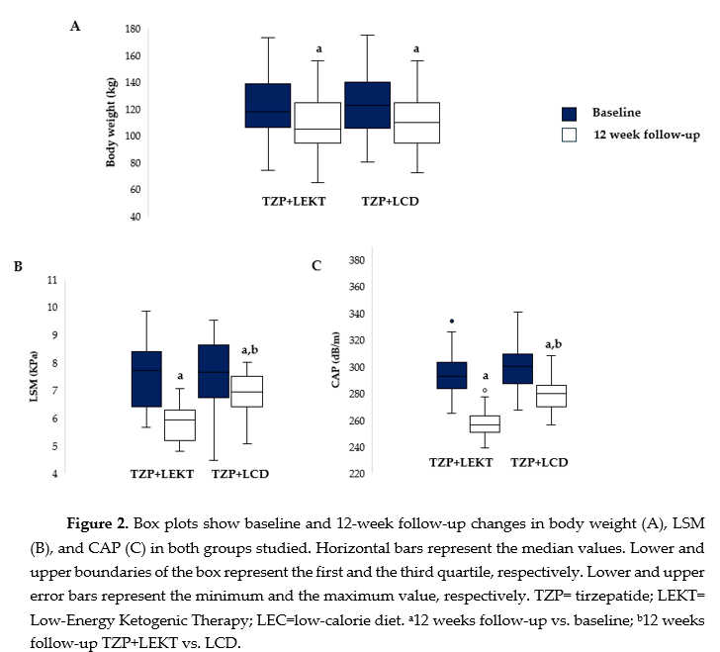
2025 Jul 24;17(15):2409

Slide 21
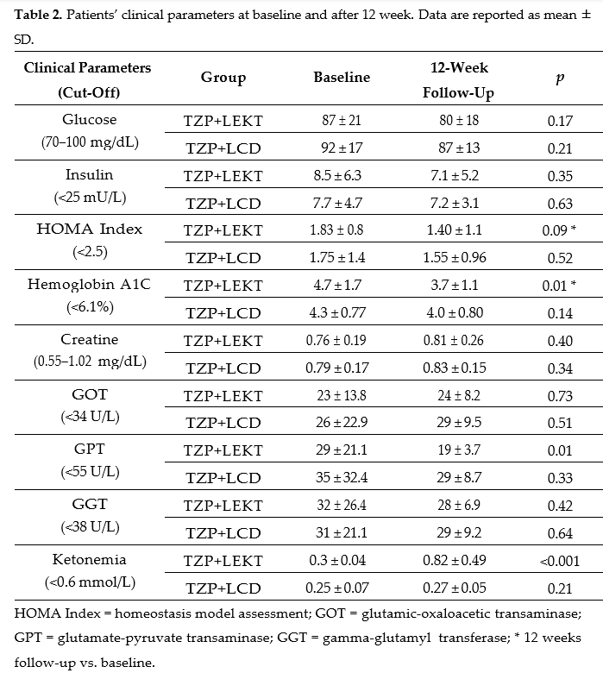
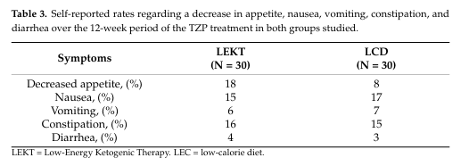
RESULTS
SURMOUNT 1 STUDY

Slide 22
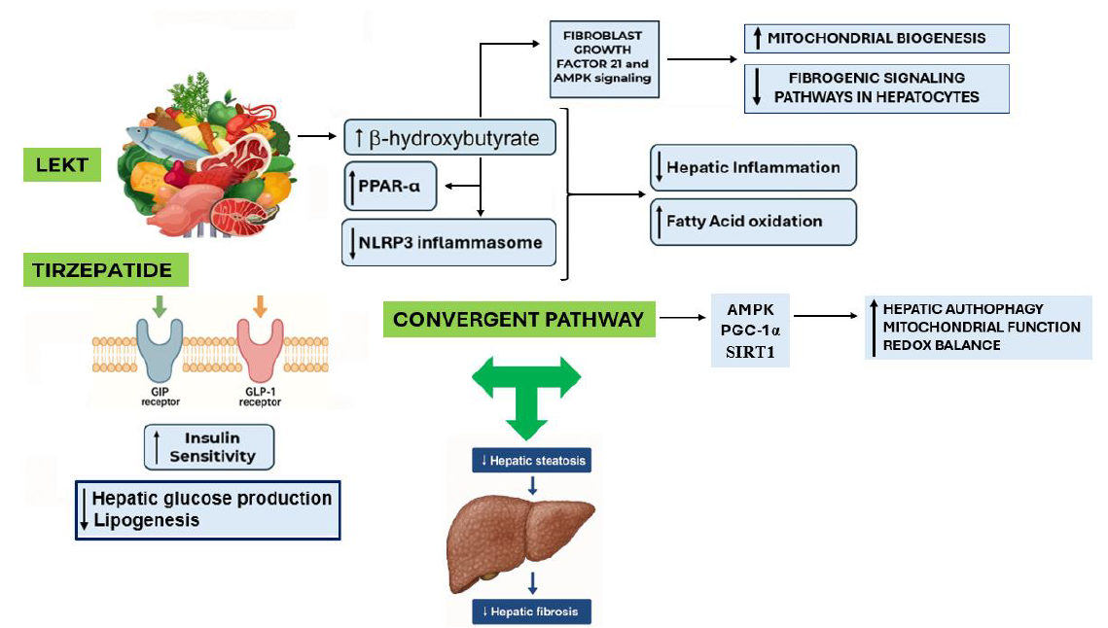
Proposed Synergistic Mechanisms of TZP and LEKT in MASLD
SURMOUNT 1 STUDY

Slide 23
CONCLUSIONS AND TAKE-HOME MESSAGE:
Based on the findings of these preliminary data, we can support the hypothesis that TZP+LEKT seems to be superior to TZP+LCD in promoting FM reduction while preserving FFM, MS, and RMR in patients with obesity, and in promoting CAP and LSM reduction in patients with MASLD
These findings highlight the potential of structured LEKT strategies to enhance TZP efficacy
However, further studies are necessary to confirm these effects.
GRAZIE PER L’ATTENZIONE
lschiavo@unisa.it

